Slide 1
Welcome to Marketing Management
Dr. Cecilia Ruvalcaba
BUSI 107 Week 14, Day 1

Slide 2

Marketing & Social Media

Slide 3
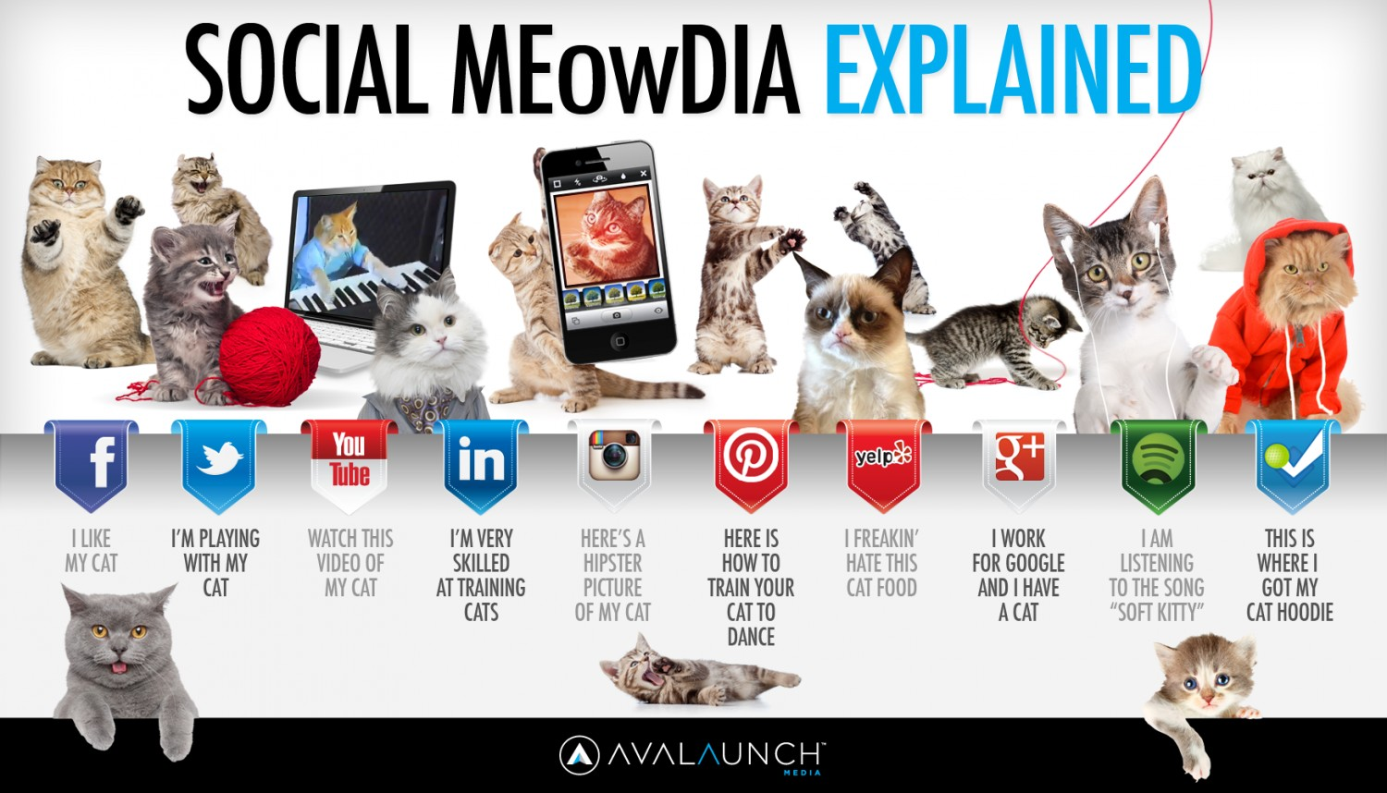
What is social media?
Social Media refers to Internet-based (Web 2.0) platforms which allow people to interact, share and exchange information.

Slide 4
Why should we care?
1995 Newsweek “Why the Web Won’t Be Nirvana”
US Internet Use/day: 4.3 hr PC; 1.3 hr Mobile
72% of all internet users are now active on social media
Who?
89% 18-29 yr olds
72% 30-49 yr olds
60% 50 to 60 yr olds
43% 65+
71% Mobile Access
52% Multiple Platforms

Slide 5

Social Media Transforming Marketing: The Empowered Consumer
United Breaks Guitars
Pass-along appeal of the content
Relational Utility- is there a point to the content worth sharing with friends? Will they think better of your for receiving it? Does it help to share a common viewpoint on a topical theme? In sum, for a network of friends does it have instrumental value?
Likeability- is it fun, engaging, novel, cute? Is the sender confident that the recipient will enjoy it? In sum, does it have expressive value?
Properties of the medium propagation
Number of friends
Proportion who will pass along content
(ease of distribution matters)
Cycle time- Time elapsed between receiving content
and passing it on.
Nyan Cat
Notes:
United Breaks Guitars (show till 1:35) : https://www.youtube.com/watch?v=5YGc4zOqozo
Kevin Allocca: Why Videos Go Viral (7:20) https://www.youtube.com/watch?v=BpxVIwCbBK0

Slide 6

Next Class
Chapter 3: Social and Mobile Marketing cont…
Marketing Analysis Paper Due 5/4
Presentations: Monday 5/2 & Wednesday 5/4

